Slide 1
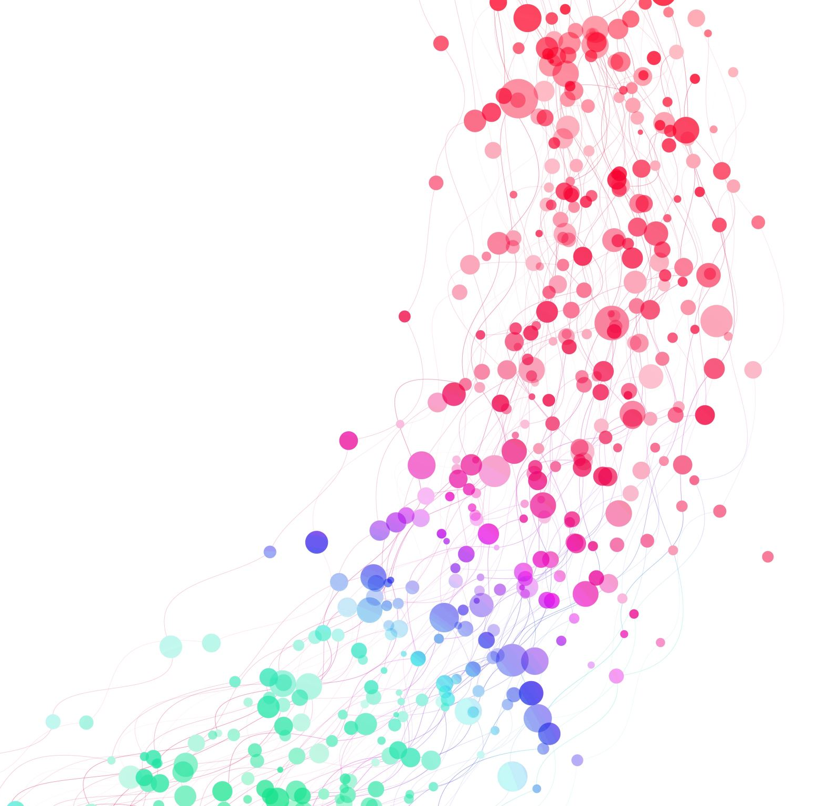
Automated Function Fitting for Intermediate Scattering Data
Yashasvi Bajaj

Slide 2
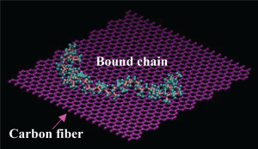
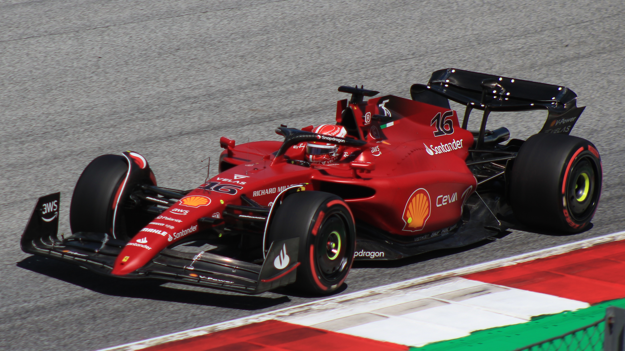

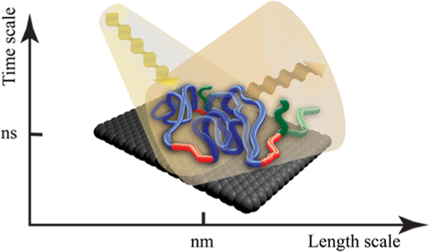
Advanced Polymer Nanocomposites -Bound Polymers-
iPP/Carbon fiber
Y. Bajaj, et al. Polymer, 265 (2023) 125584.
PB/Carbon black
https://www.ferrari.com/en-EN/formula1
D. Salatto, et al. Macromolecules, 54 (2021) 11032.
Notes:
To briefly introduce the topic, polymer nanocomposites (PNCs), having the advantages of high stiffness, lightweight, and utility for manufacturing, are already being used in many areas of industry.
For example, by adjusting their macroscopic properties, carbon fiber reinforced polymers (CFRPs) can be utilized into the bodywork of cars to help make them lightweight, whereas carbon black reinforced polymers can help increase the tires’ grip.
This results in improved fuel efficiency, and, by extension, produces less carbon-based fuel waste.
In addition, it has become well established that one of the most important microscopic parameters that controls the macroscopic properties of nanocomposites is the interface between polymer matrix and nanofiller, which consists of physically bound (i.e., physisorbed) polymer chains that are in contact with the nanofiller surface.
Our present work focuses on an isotactic polypropylene (iPP) matrix in contact with a CF surface, where we aimed to characterize the dynamics at the interface between bound iPP and CF.

Slide 3
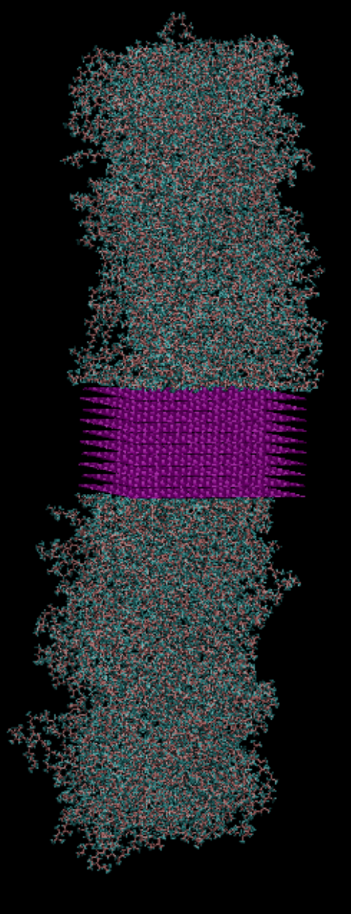
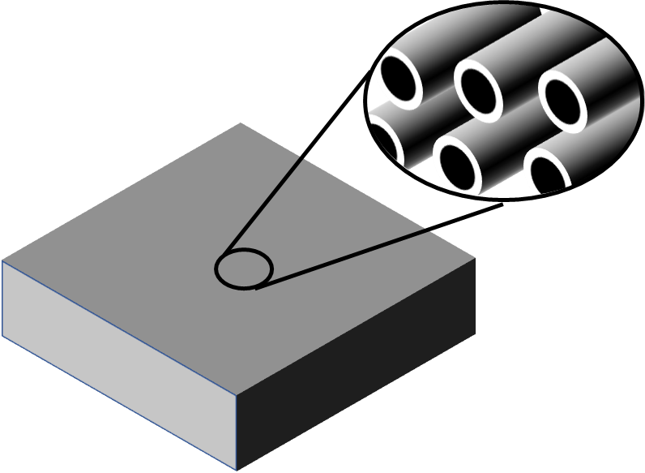
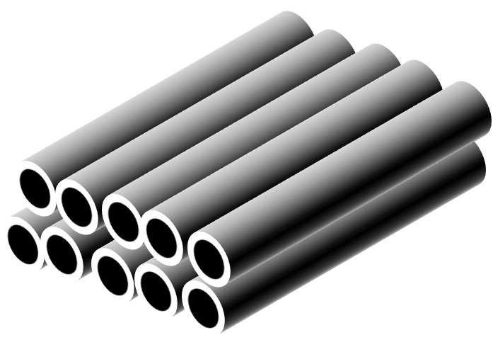

Goal
Integrate a suite of experimental and computational approaches to strengthen our understanding of the structures and dynamics at the iPP/CF interface.
Extracted iPP bound polymer layer (BPL) on carbon fiber (CF)
CF
BPL-coated CF
iPP Bound Chains
iPP matrix
CF
Solvent rinsing with
p-xylene
Neutron scattering
Atomistic MD simulations
Y. Bajaj, et al. Polymer 265 (2023) 125584
Notes:
We first prepared the bound polymer layers by cleaning bare carbon fibers in an ultrasonic bath, then compression molding them into an iPP matrix. This was followed by solvent rinsing with a heated solvent to leave only the bound polymer layer.
With the prepared samples, we then performed several neutron scattering techniques to characterize the structural, spatial, and temporal information concerning the bound polymer.
We then developed atomistic molecular dynamics (MD) simulations that were performed to mimic the scattering results and provide more detailed insights to the data.

Slide 4
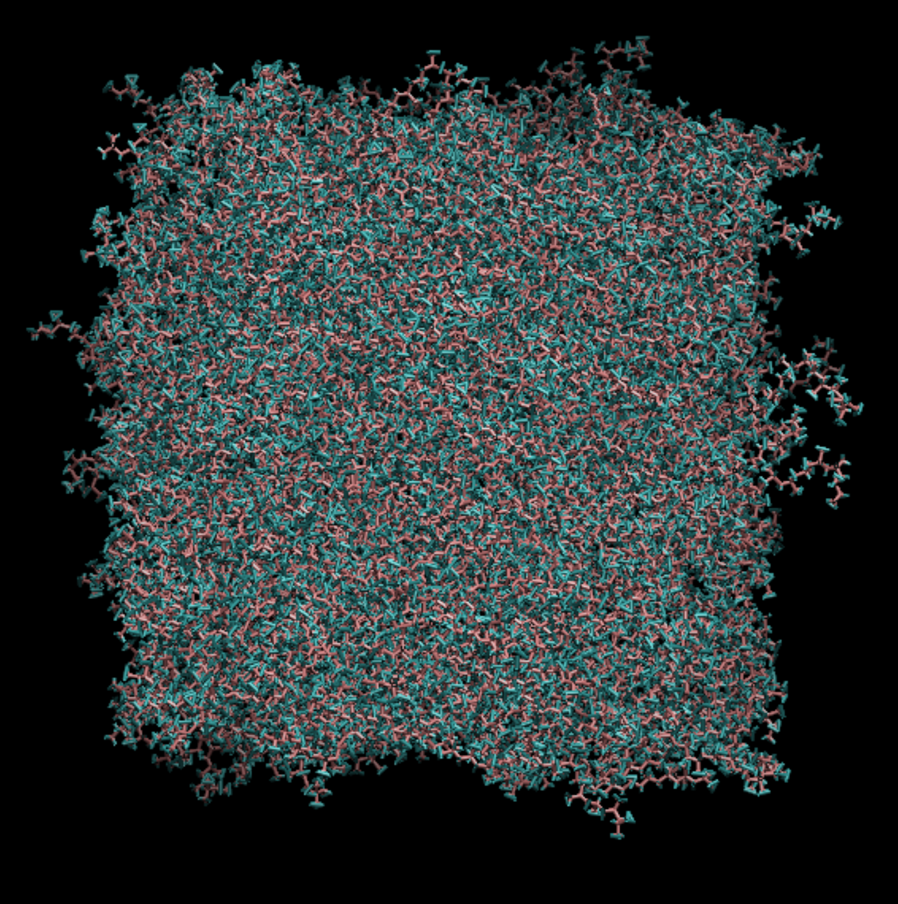
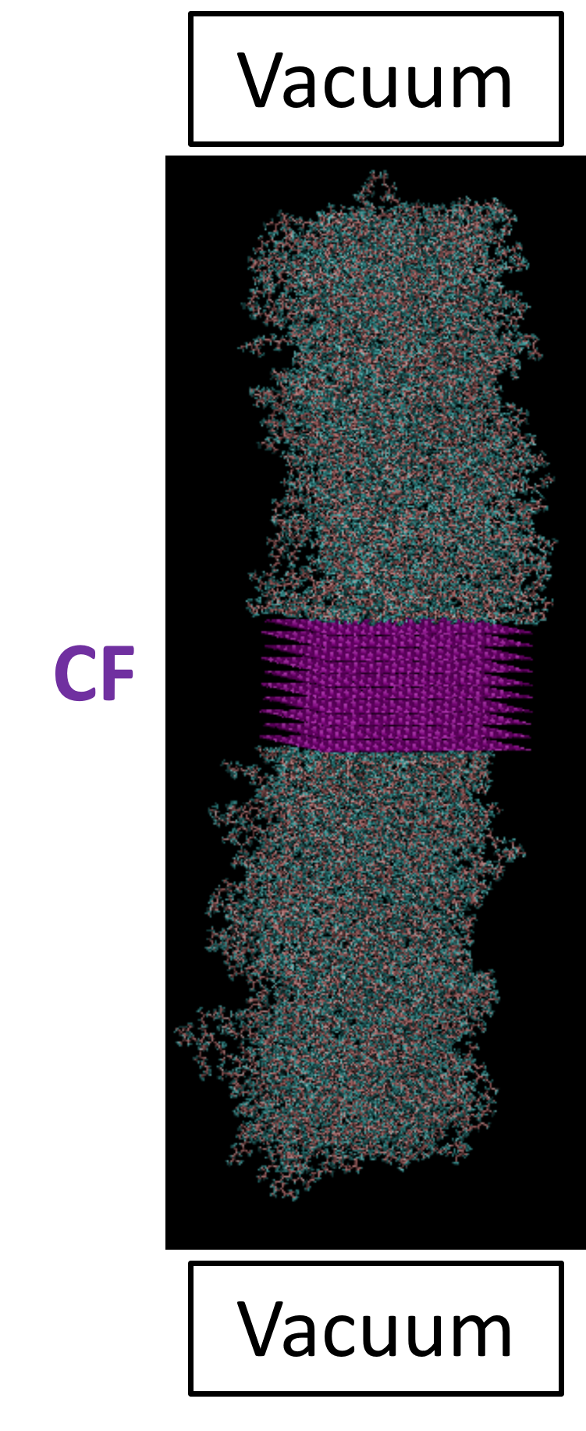
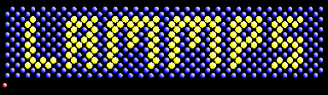
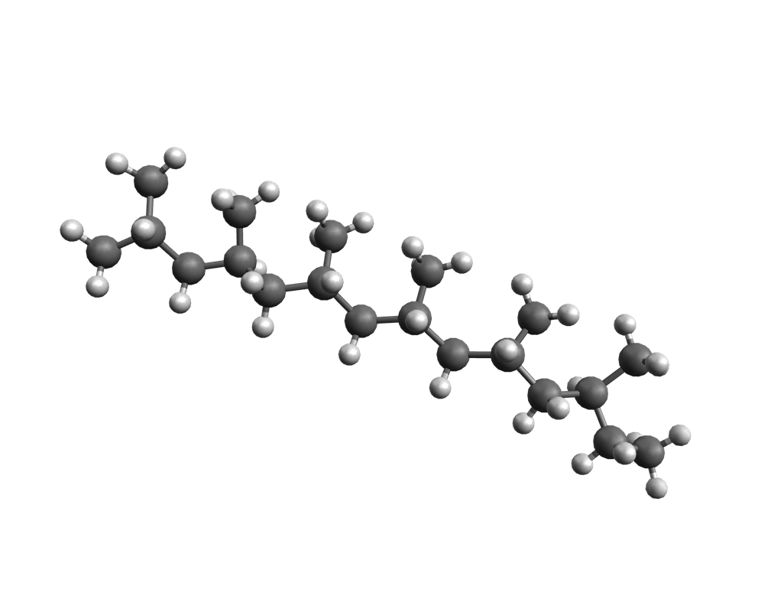
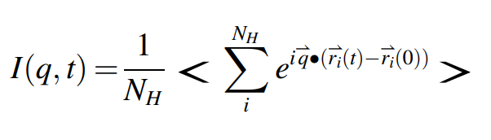
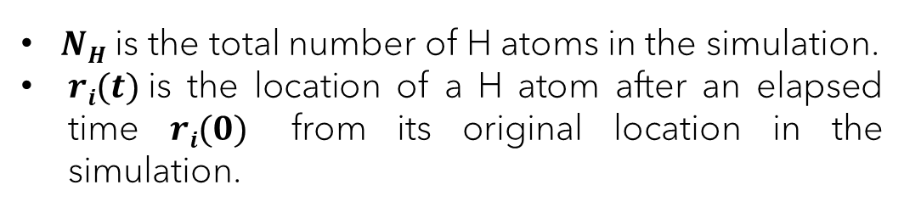
Atomistic Molecular Dynamics (MD) Simulations
(“Free Chains”)
(“Bound Chains”)
x, y, z, xu, yu, zu
(coordinates in LAMMPS)
Self-motion of H atoms
Dynamics Parametrization:
iPP (N=30)
$NH$ is the total number of H atoms in the simulation.
$ri(t)$is the location of a H atom after an elapsed time $ri(0)$ from its original location in the simulation.
Notes:
To develop the simulations, we used LAMMPS software. We created both a “free chains” system, lacking a CF substrate, and a “bound chains” system to mimic the bound polymer layer.
So, after equilibrating each system, we ran production runs for 15 ns to sample atomic trajectory data up to 1 ns which included spatial coordinates in x, y, and z, and their unwrapped counterparts.
The intermediate incoherent scattering function I(q,t) was then calculated from the simulation trajectory data. This is the spatial Fourier transform of the self-part of the Van Hove correlation function. With this data, we have access to the spatial and temporal information that we can correlate with in-situ neutron scattering.
Since the self-motion from hydrogen atoms dominates the measured signal in the dynamic incoherent space, we treated N_{H} as the total number of hydrogen atoms in the simulation, whereas r_{i} was treated as the location of a hydrogen atom after an elapsed time from its original location in the simulation.

Slide 5
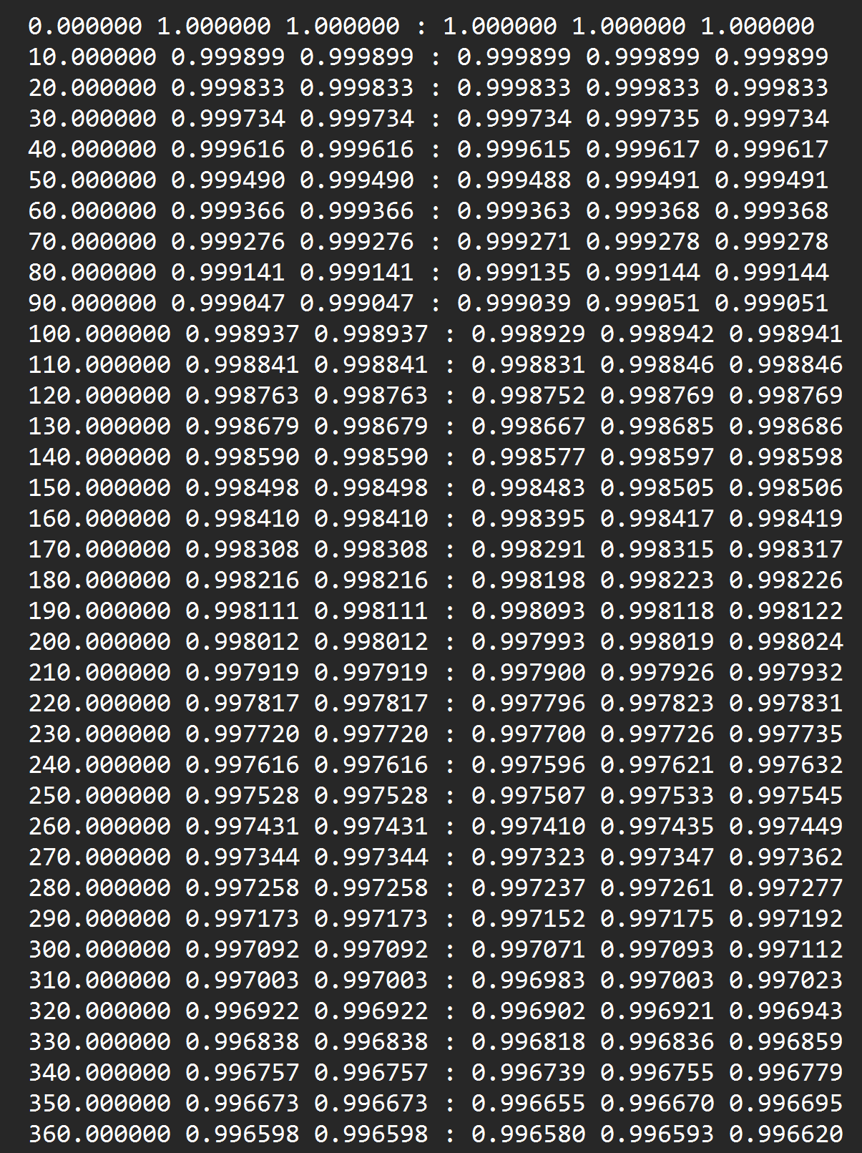
I(q,t) Data Files
We have an in-house C code to calculate I(q,t). It can be run from the shell.
Sampling:
0 → 2000 fs (steps of 10 fs)
5000 → 1e6 fs (1 ns)
Columns:
1 → timestep
2 → (I(q,t)[x] + I(q,t)[y] + I(q,t)[z]) / 3
15 data files, corresp. to 1 nm⁻¹ < q < 15 nm⁻¹.
Notes:
This data structure corresponds to both the free and the bound chains.
For future reference, we will be fitting the calculated I(q,t) data from columns 1 and 2 with a series of functions. The other columns correspond to I(q,t) that was calculated for individual directional components of atomic trajectories, i.e., x, y, and z. There is also one column where we calculated I(q,t) using a different method.
For the 15 data files, the q represents the spatial information. It’s basically a scattering vector that shows a decay over time in the same sampling range that I just discussed.

Slide 6
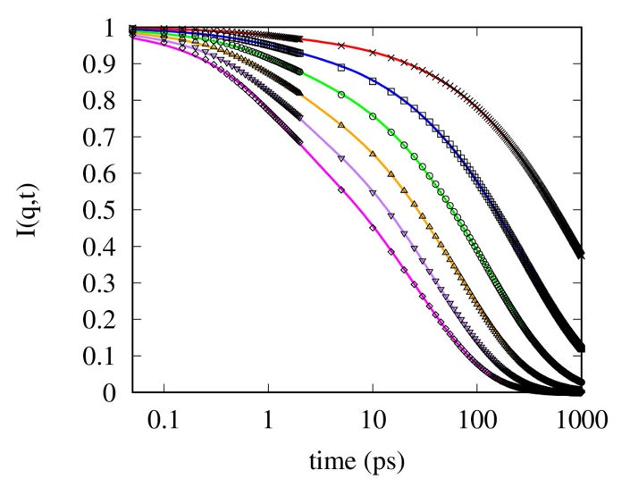
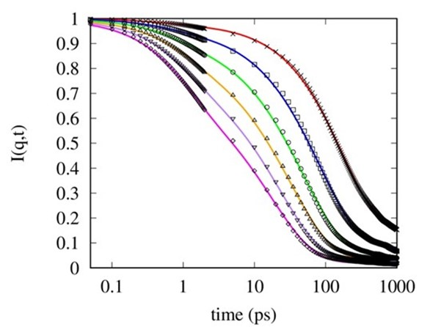

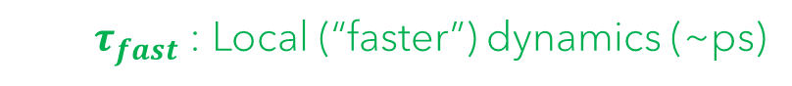
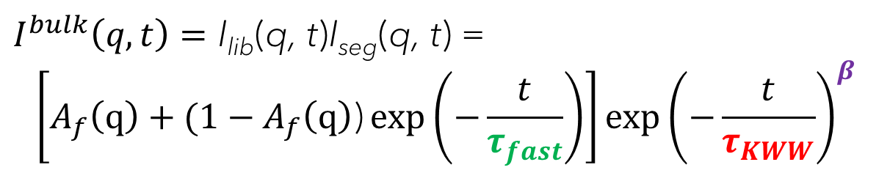
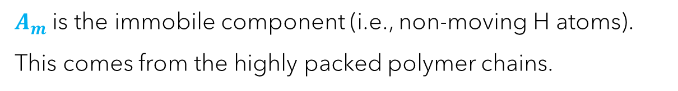
Segmental and local dynamics of free and bound chains
Free Chains
$I^{bulk}\left(q,t\right)=\text{I}\text{lib}\text{(}\text{q}\text{, }\text{t}\text{)}\text{I}\text{seg}\text{(}\text{q}\text{, }\text{t}\text{) }$=
$$\left[A_{f}\left(q\right)+(1−A_{f}\left(q\right)\text{)}\exp\left(−\frac{t}{τ_{fast}}\right)\right]exp{\left(−\frac{t}{τ_{KWW}}\right)}^{β}$$
$τ_{fast}$ : Local (“faster”) dynamics (~ps)
$τ_{KWW}:$Segmental (“slower”) dynamics (~sub-ns)
$β$: stretching exponent
Bound Chains
$I^{bound}\left(q,t\right)=\left[{I^{bulk}\left(q,t\right)(1−A}_{m})+A_{m} \right]$
$A_{m}$ is the immobile component (i.e., non-moving H atoms).
This comes from the highly packed polymer chains.
Macromolecules 2008, 41, 4, 1560.
Notes:
First, we characterized the dynamics of the free chains by fitting their I(q,t) data with a stretch exponential equation, using the Kohlrausch-Williams-Watts form. This gave us several parameters, including:
$τ_{fast}$, describing the local hydrogen dynamics that are unaffected by neighboring molecules, and on the order of ps;
$τ_{KWW}$, describing the segmental dynamics that are typically slower, and representative of the whole chain, on the order of sub-ns. This parameter was used for the direct comparison to experimental data, which I will show in the following slide.
B, which was the accompanying stretching exponent used to describe the decay of the slower motion over a range of q-values.
In fitting the bound chains data, we retained the bulk fitting equation, but added an additional floating parameter, denoted A_{m}, to describe the immobile, or non-moving fraction of the bound chains.
According to theory, the immobile component comes from the highly adsorbed polymer chains (i.e., those chains comprising a ‘flattened layer’).

Slide 7
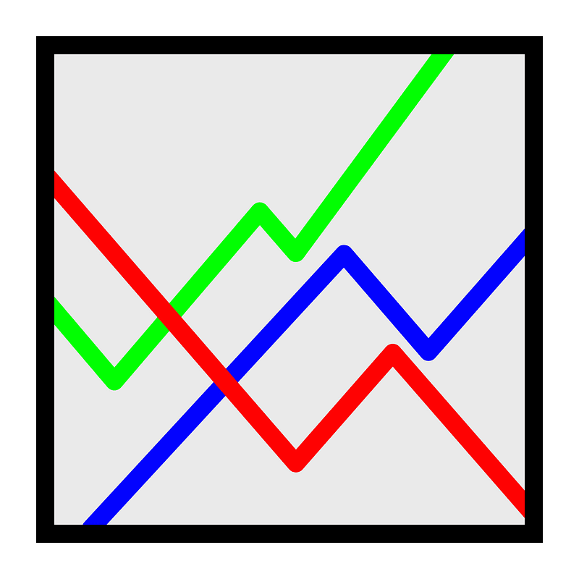
The Problem
We are currently using a Gnuplot script to fit and plot the results
Gnuplot has very high-quality figure rendering, but it can take a lot of time to input reasonable guesses for parameter fitting
Gnuplot automation can be unwieldy with functions, e.g., changing your guess for a parameter if it initially returns an undefined value

Slide 8


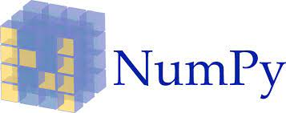
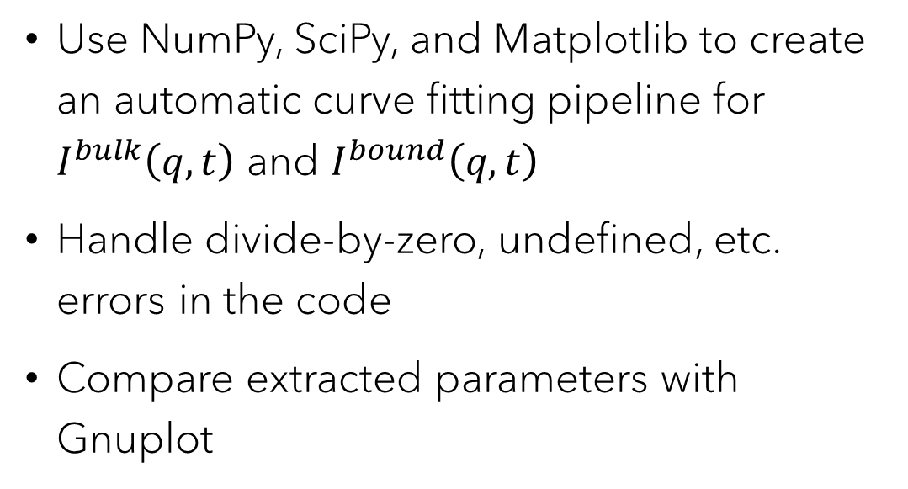
Objective
Use NumPy, SciPy, and Matplotlib to create an automatic curve fitting pipeline for $I^{bulk}\left(q,t\right)$ and $I^{bound}\left(q,t\right)$
Handle divide-by-zero, undefined, etc. errors in the code
Compare extracted parameters with Gnuplot

Slide 9
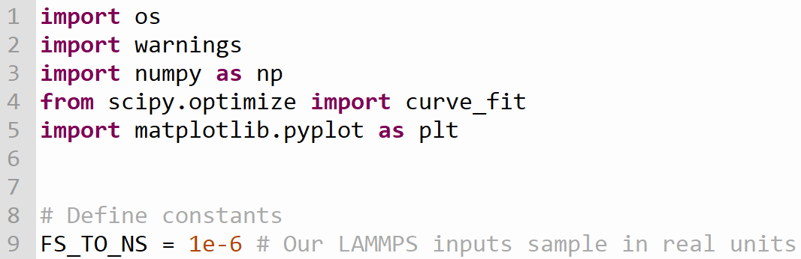
Modules and Global Variables
Neutron scattering is measured on the order of ps to 1 ns and nm, respective to time and length scales
Our LAMMPS input scripts sample in fs and Å, so we need a conversion factor for direct comparison

Slide 10
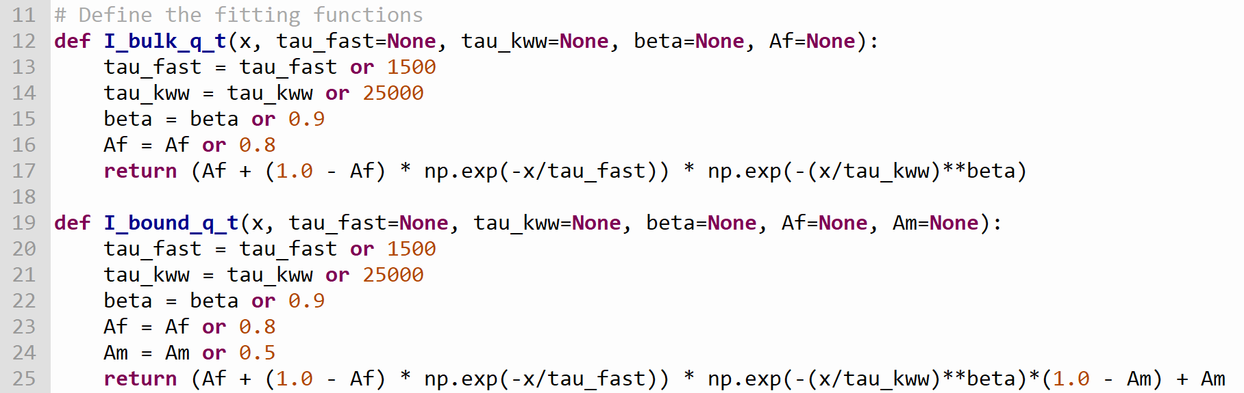
Model Functions

Slide 11
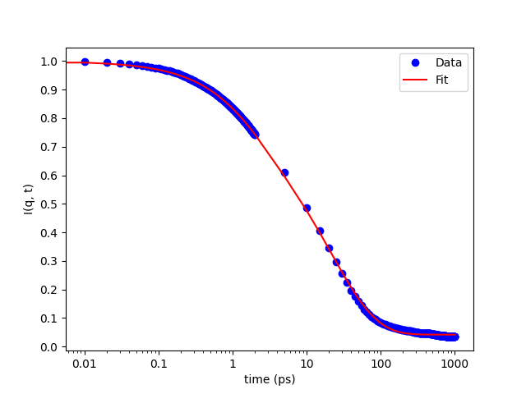
Imported Functions
scipy.optimize.curve_fit
Assumes ydata = f(xdata, *params)
Applies nonlinear least squares
Takes f, xdata, ydata, and p0 as parameters, where
f → the model function f(x, …)
xdata → the independent variable
ydata → the dependent variable
p0 → initial guesses for parameters
Notes:
p0 corresponds to the parameters which we are estimating through our model functions I_bulk_q_t and I_bound_q_t. It is stored in a Python list. curve_fit applies the nonlinear least squares algorithm to fit the model functions to data; in this case, our computed I(q,t) data from the in-house C code.

Slide 12
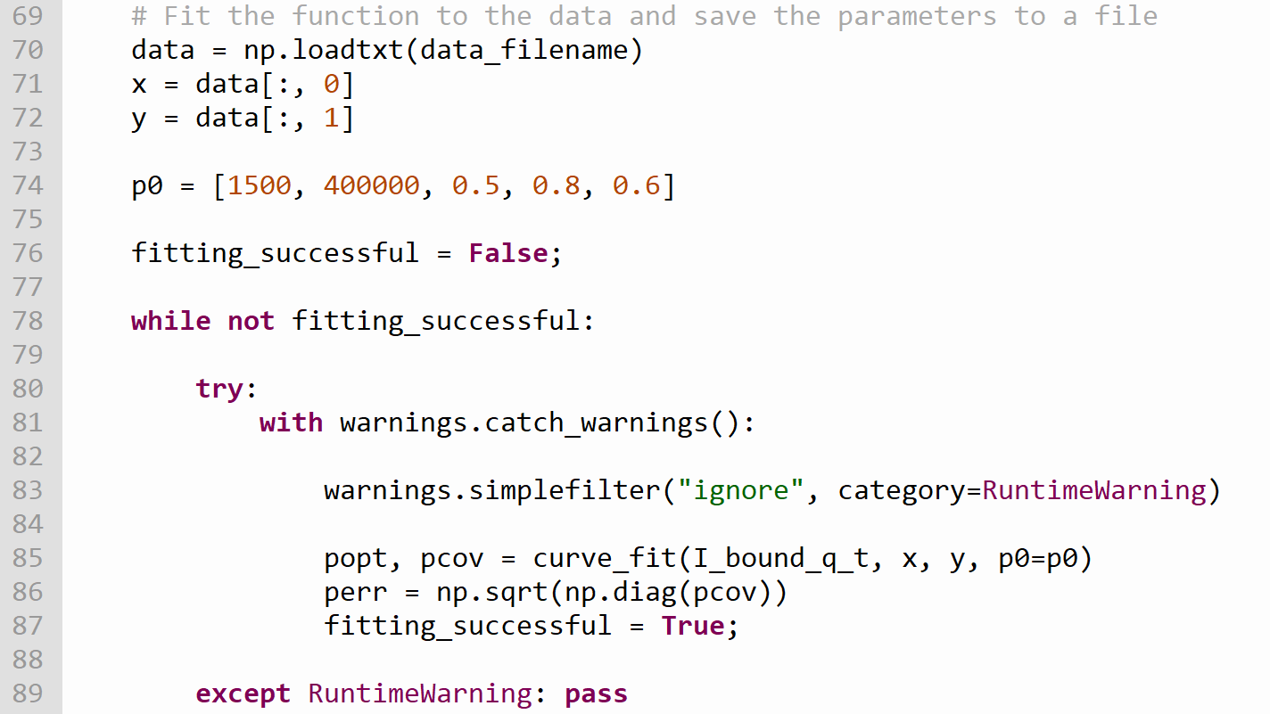
Returns:
popt → Optimal values for the parameters so that the sum of the squared error of f(xdata, *popt) - ydata is minimized
pcov → Estimated covariance of popt, error computed to one standard deviation
Notes:
So, you can see that we used columns 1 and 2 to create arrays to store x and y data, corresponding to timestep and I(q,t). Obviously, I specified the data in a string for the path to the folder where it’s located on my laptop.
I then used a while loop to initialize a filter that catches RuntimeWarnings and ignores them. Basically, by doing this, we’re kind of trusting that our initial guesses are good enough for the curve_fit algorithm to give us an accurate fit, and that any divide-by-zero or RuntimeErrors do not affect performance. If they do significantly affect performance, we’d see some strange things happen on our plots, so we’d have to catch that. But in this case, SciPy could handle those errors.

Slide 13
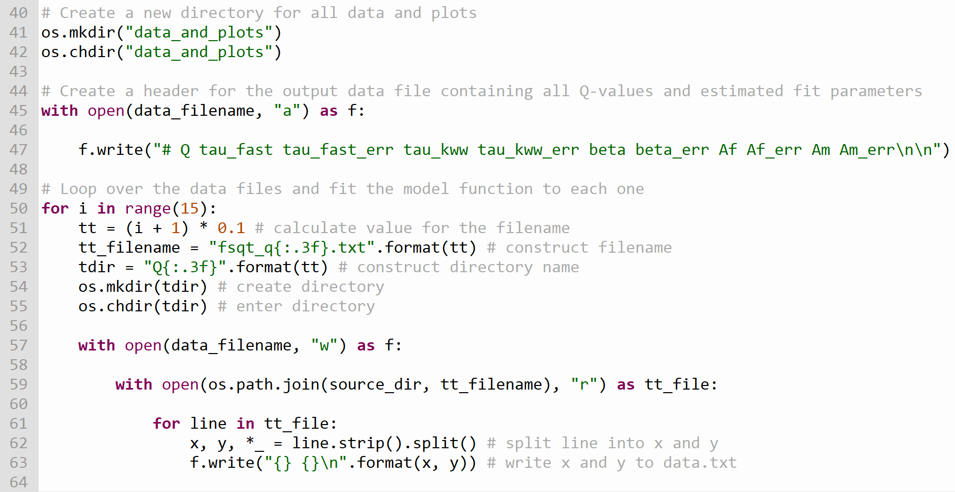
Looping through the 15 q-values and creating a separate data file for each one, as well as a master file to store all fit data

Slide 14
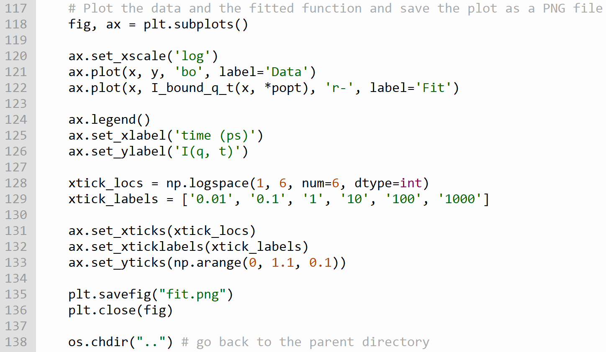
Calling Matplotlib to plot the data with logscale x
The decay at high-q is extremely small!

Slide 15
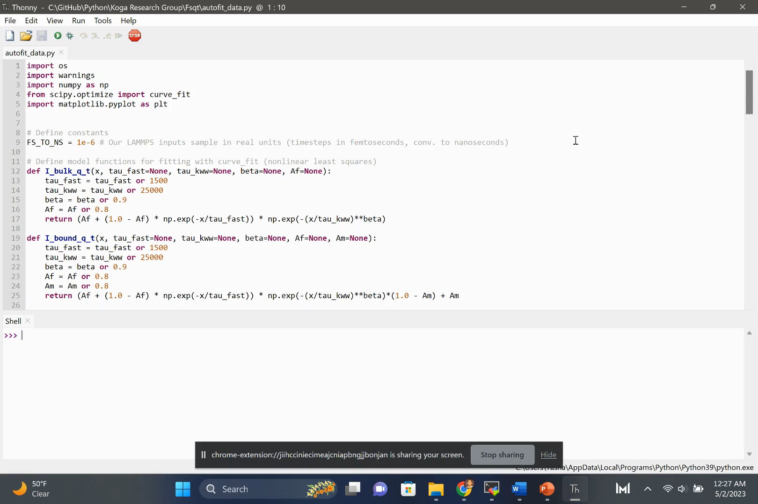

Slide 16
Results
tau_fast, tau_kww, and beta are almost identical to those estimated by Gnuplot
We can more safely ignore RuntimeWarnings
Speaking of runtime… only ~10 seconds to fit both functions at once!
Af and Am coefficients deviate from Gnuplot estimates significantly, so we will need to investigate further
Y. Bajaj, et al. Polymer, 265 (2023) 125584.

Slide 17
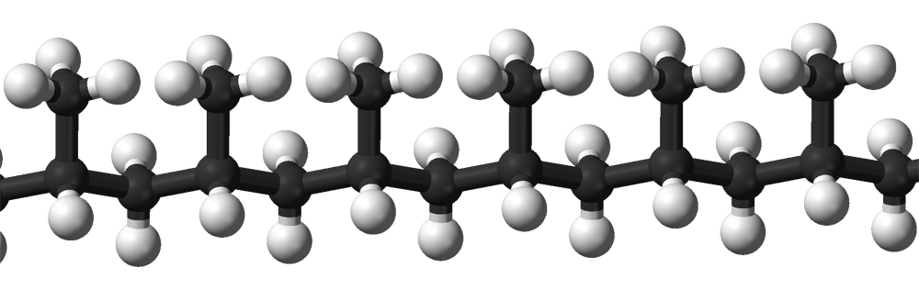
Future Work
iPP is a simple molecule in terms of stereochemistry.
We need to test this code’s characterization of molecular dynamics for molecules with bigger side groups than –CH₃ to see if the accuracy is retained.
We may need to modify our fitting functions by including a third characteristic time component for the rotation of methyl groups.
Currently, we only have characteristic times for “fast” (local) dynamics and “slow” (segmental, i.e., whole-chain) dynamics.

Slide 18
Q & A

